Slide 1
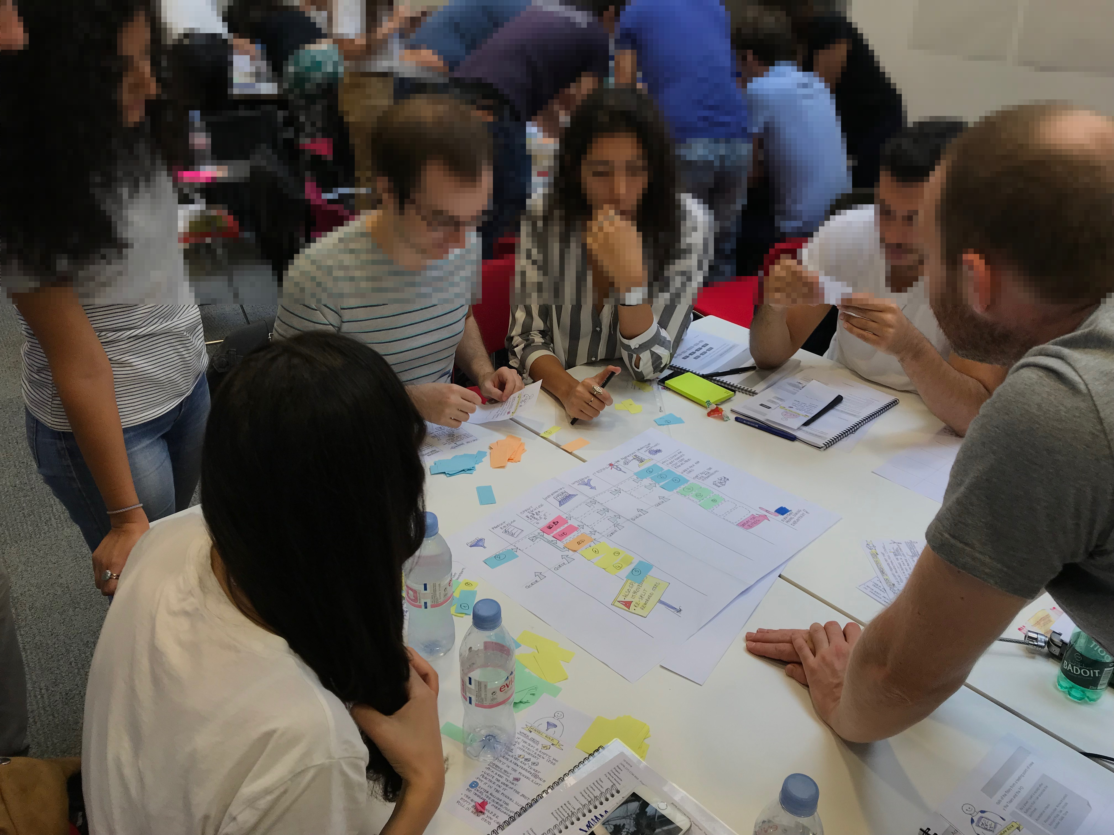
The built-in quality game!
Notes:
5m | 0m -> 5m
----
Welcome to this built-in quality game.
The goal of this game is to make you feel the effects of built-in quality on the value flow.
## Goal of the game To pull as many features from Idea to Production as possible.
Experience the increase in value delivery as we add more built-in quality to our software development process.

Slide 2

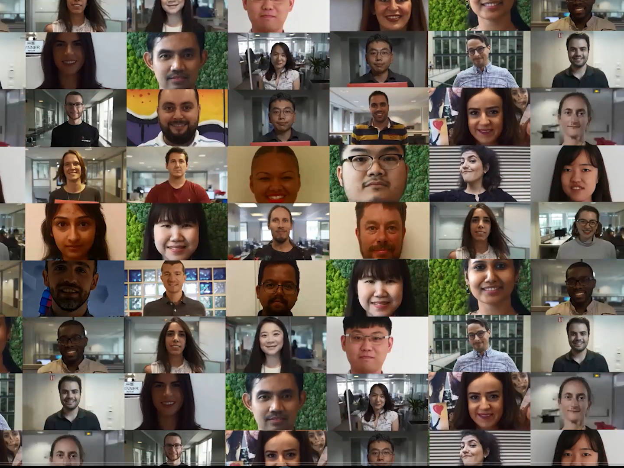
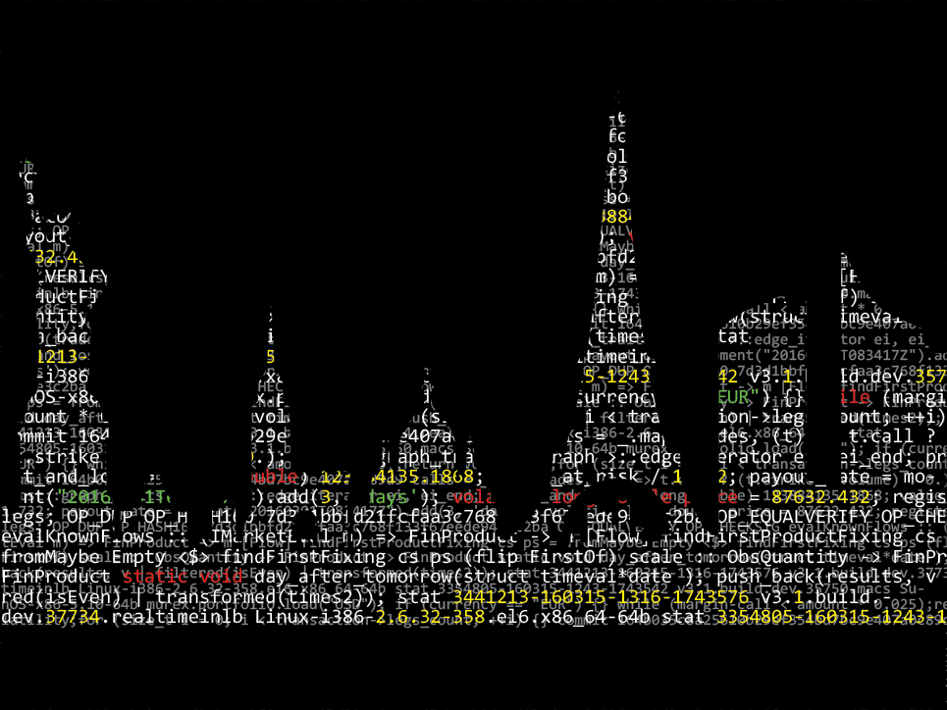
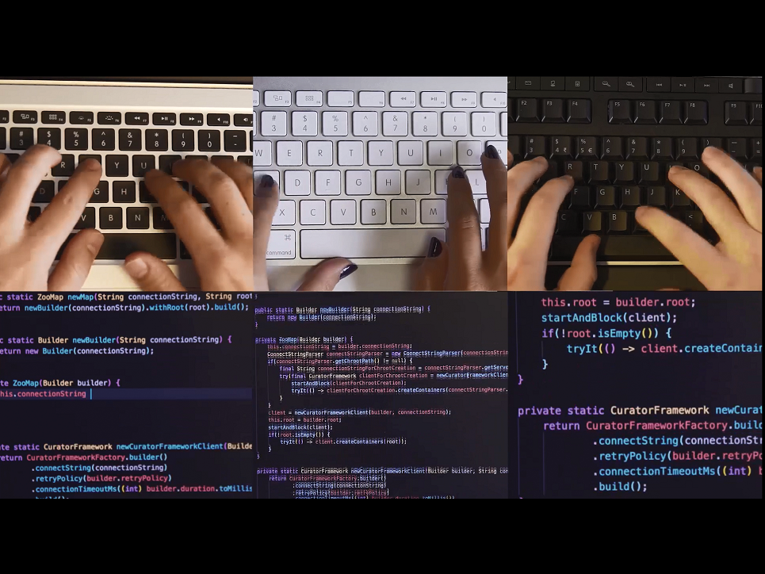

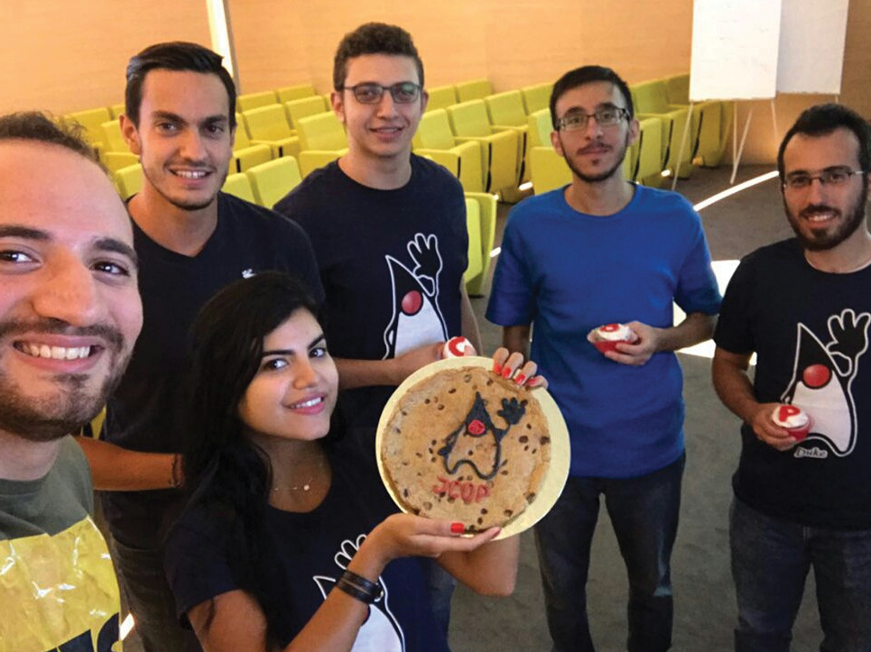
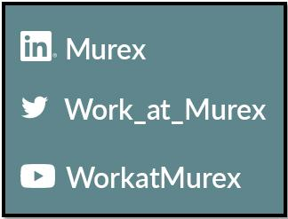
2000+ teammates 500+ developers
Around the
world
Developing
Software…
…for Capital Markets
With passion!
Follow us
Notes:
1 - I don’t know if many of you know Murex, so let me introduce us in one slide.
2 – We are 500 developers in a company of 2000 passionate people.
3 – We work across 17 offices around the world…
4 + 5 – We develop Software for Capital Markets which means that we create and improve code for hundreds of Financial Institutions across the world. We also have teams who implement and support the software. (As a developer at Murex, I work on areas such as … (domaine modeling – estimating value – risk – dashboarding – integration))…
6 – Because we love sharing our passion, Murex is active in the meetup and dev community scene
7 – To not miss our next community event such as Meet-ups or Coding Games , follow us on Social Media. Of course don’t hesitate to tweet about this meet-up tonight, use the tag « @Work_at_Murex » and we will re-tweet!

Slide 3

Think it then ink it!
“ Think about what you already know about built-in quality.
Write three of these facts on an index card.
Be ready to state them when asked. ”
Notes:
5m | 5m -> 10m
----

Slide 4

One-person expert Jigsaw
You each received different information about built-in quality
Exchange with your colleagues until one of you feels ready to summarize the full content to all the table
from Wikipedia, licensed under the Creative Commons Attribution 3.0 Unported license.

Slide 5
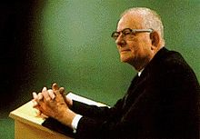
“Inspection does not improve the quality, nor guarantee quality. Inspection is too late. The quality, good or bad, is already in the product. Quality cannot be inspected into a product or service; it must be built into it.”
—W. Edwards Deming
From Wikipedia
Notes:
2m | 10m -> 12m
----
### Built-in quality Presentation
Here is the key idea behind built-in quality: the earlier in the delivery process an error is made, the more waste it will generate until the feature satisfies the customer. The earlier we fix an error, the better! For example: * If you build the wrong product, the design, coding, testing... in fact *all* the work on this product will be wasted * If a developer leaves a bug in his implementation of a feature, this will limit waste to testing, support and rework * At the other side, if an error is left in delivery configuration, then it should be fixed very cheaply

Slide 6
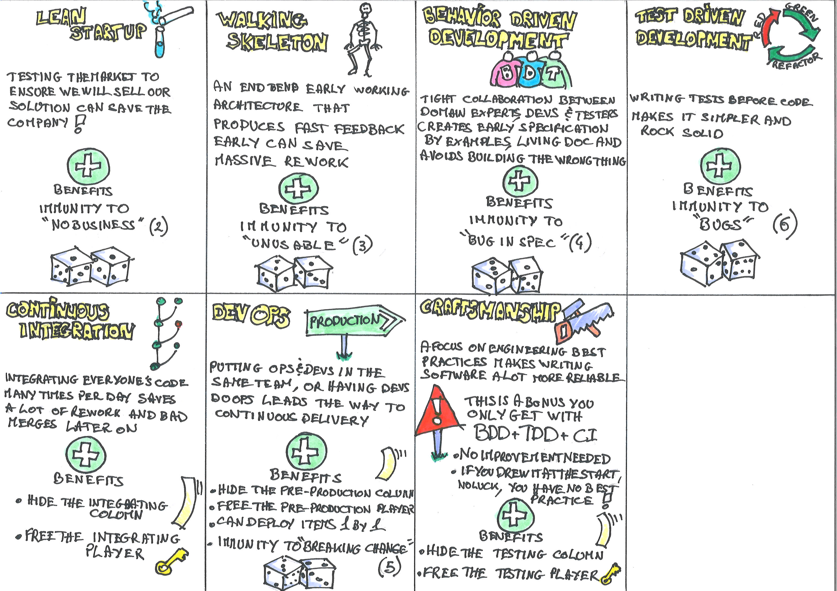
Notes:
3m | 12m -> 15m
----
Built-in quality is a set of practices and principles that enable to avoid errors in the first place, instead of trying to fix them later.
Can you give examples of practices?
Typical built-in quality practices include: * Test Driven Development * Behaviour Driven Development * Continuous Integration * Dev-Ops * Walking Skeleton * Lean Startup
We want to illustrate this with a game. We'll see how mastering these techniques increases the rate at which we can deliver value.

Slide 7
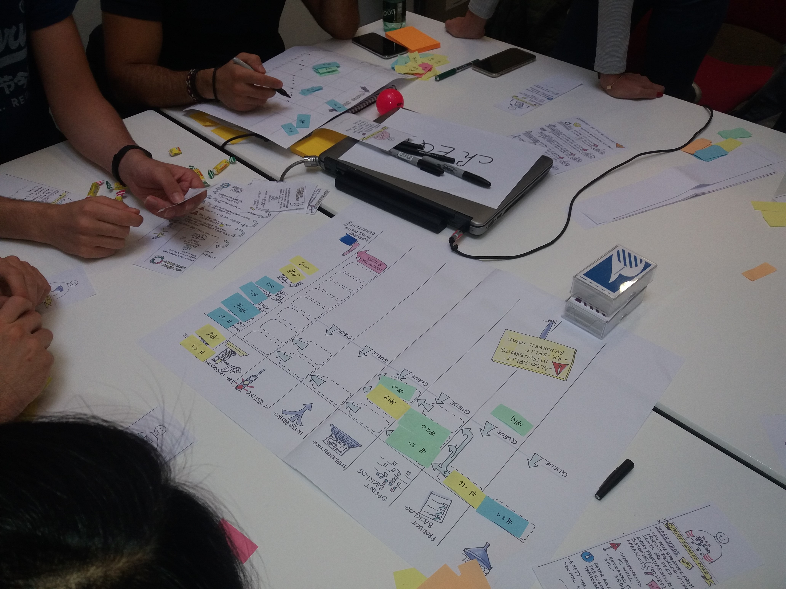
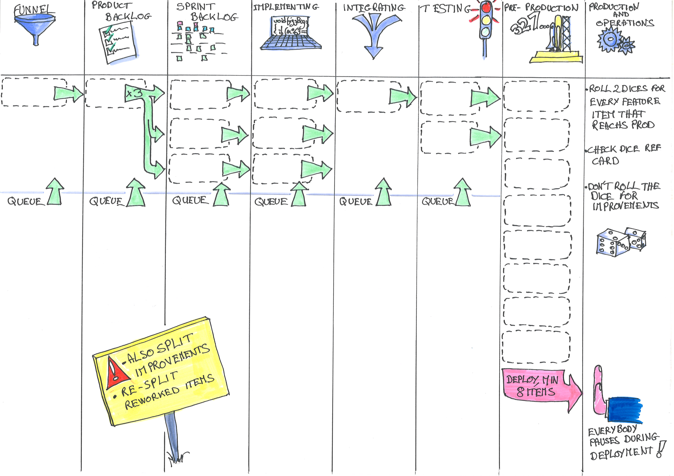
Notes:
2m | 15m -> 17m
----
## What it looks like You are a team of fresh grad starting a new project. You have a lot of ideas, but everything is still to do. During the game, we'll represent building the product as a Kanban board, and work items as small colored pieces of paper.
At first, as a fresh grads, you'll suffer from your lack of build-in quality practice. As time goes, and as you master industry best practices, you'll see your value delivery rate increase.
Every team member will take one 1 or more roles and will be responsible to pull work items in his column. If something goes bad when an item reaches production, it will have to be reworked. Regularly, you can chose to work on mastering new practices instead of features. The more best practices in place, and the smoother the release will become.
The game is played in rounds (representing days). During a round, each team member can pull items from the previous column. It's only when all the players have pulled their work items, that we can move to the next round.
The game ends when you feel you have learned enough. Take the opportunity to discuss your insights with other participants.
The material is built to be as self-explanatory as possible. So it should be possible to have people play without reading the full instructions up-front.

Slide 8

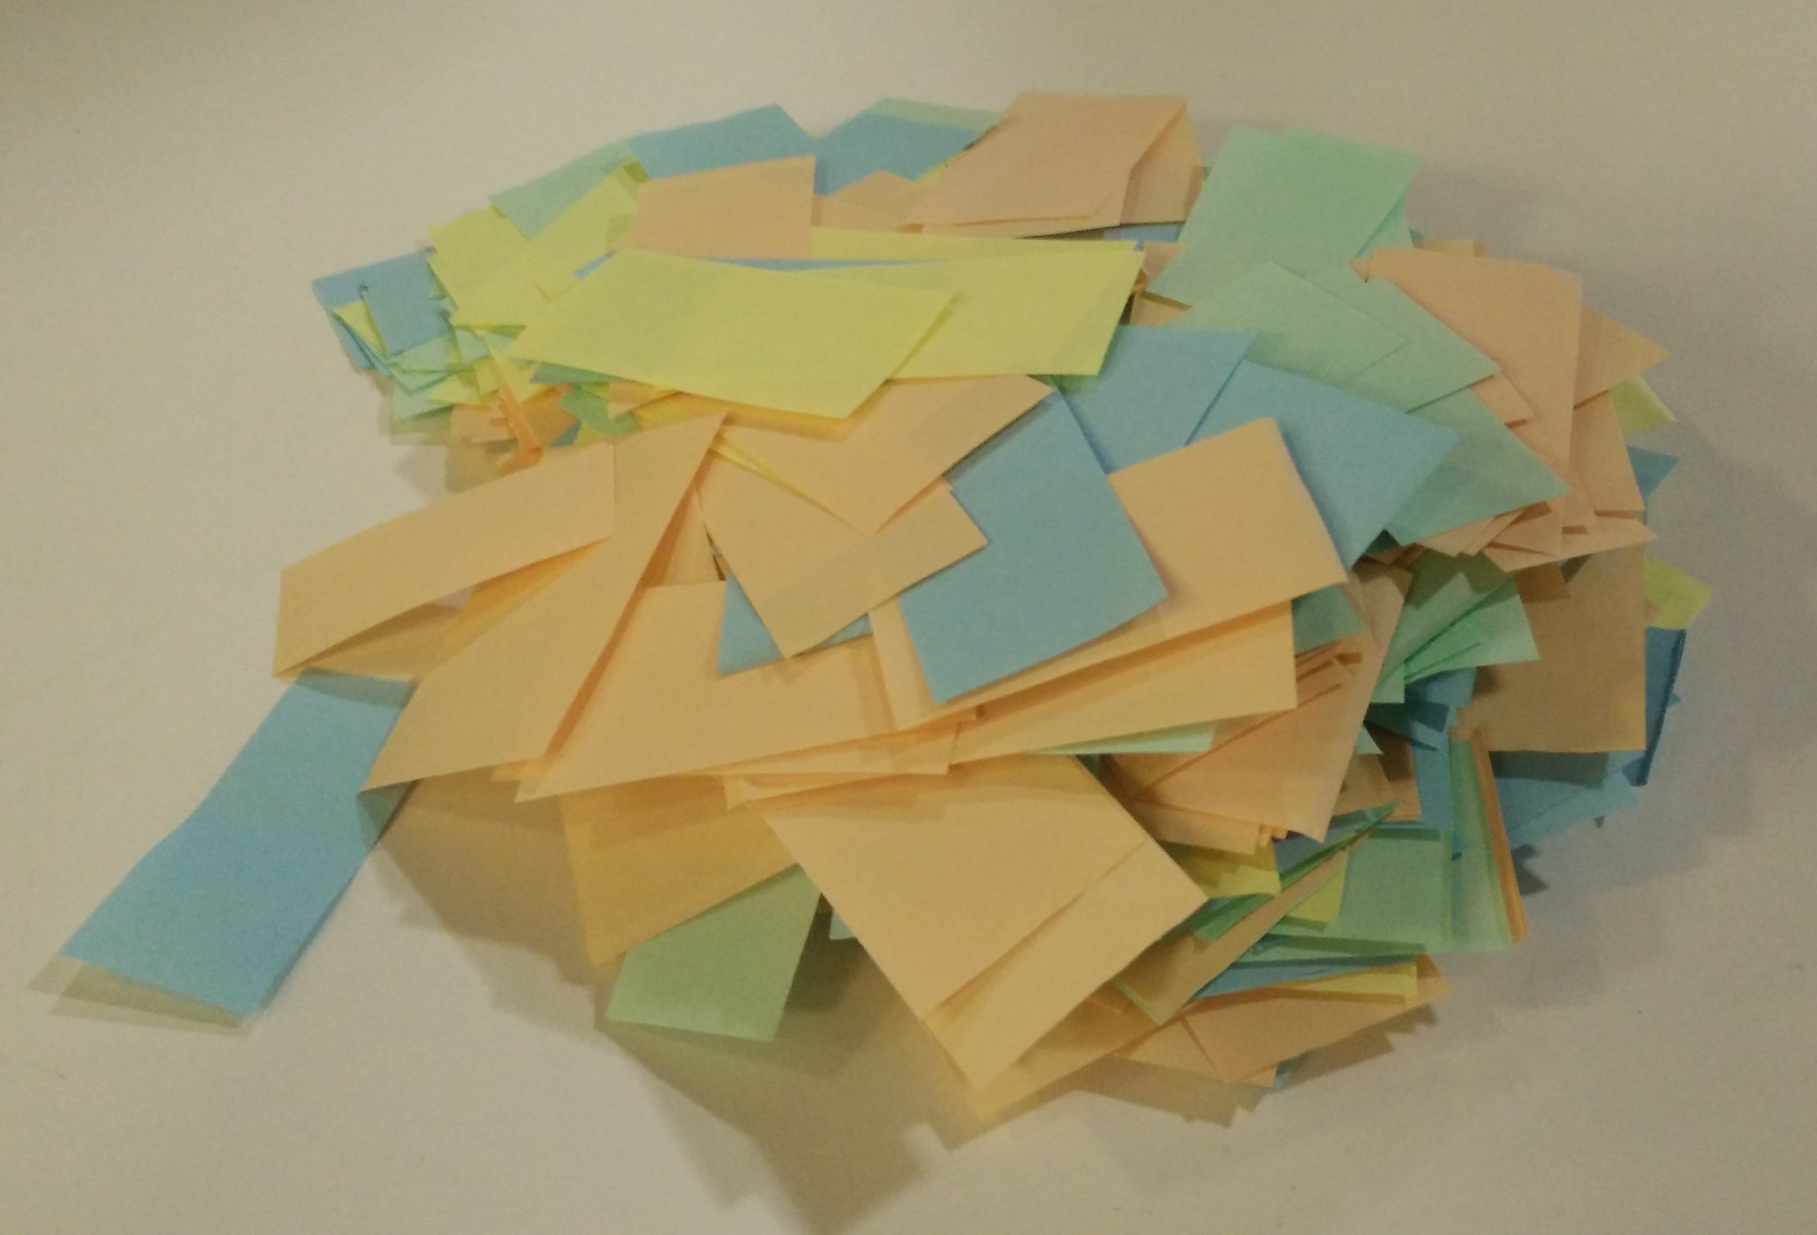
Let’s start to play!
Track on this shared online spreadsheet and compare how you are doing with other tables!
https://bit.ly/2Pr8nWS
Create a team of up to 8. Mix profiles!
Open the 'Level 0' sleeve
Kanban
Tickets
Tracking sheet
8 role cards, pick 1 or 2!
2 dices and dice reference card
Full rules, just in case
...grasp the game...
Question? Ask an animator!
Notes:
8m | 17m -> 25m
----
Create a team of up to 8. Try to mix profiles (technical, business, test...) to maximize learning
Let's open the 'Level 0' sleeve together
you have the kanban board, where you'll try to pull items from idea to production.
there are color tickets that represent the work item that will move through the kanban board
there is a tracking sheet, to track how many complete features you have delivered at every round. Optionally, the production-role person can use a laptop and a shared spreadsheet (instead of a sheet of paper) to track the progress throughout the game.
you have 8 role cards. You'll each be responsible for one or more columns on the kanban board. Each team member should pick one or more roles (preferably in adjacent columns), and read their role(s) reference card.
2 dices and a dice reference card. When you'll try to deliver things to production, you'll roll the dices to see the outcome. If a problems occurs, the item will be go back to a previous column to be reworked.
there are the full rules of the game. In case there is something that is not clear about the rules, you should find the answer there.
Take a few minutes to get a global grasp of the game.
It should all become clearer as we start to play. You can ask an animator if you are in doubt.

Slide 9
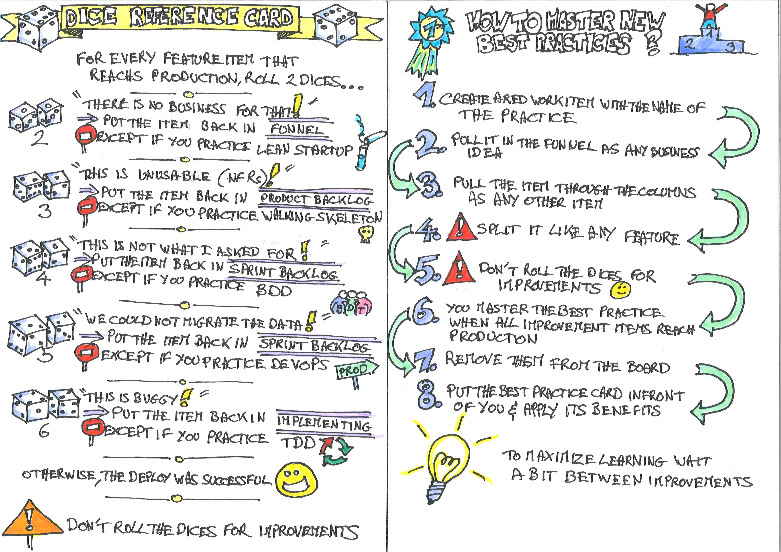
Level 0, discover the game
Reminders and notes
Production player: don't forget to keep track of what's going on!
It’s not a good idea to pile work in queues
Run the dice for every work item, not once per delivery or feature
If in doubt: check the rules, or ask an animator
Let's start all together
The production player keeps track of features!
Every round, from right to left, players pull work in their column if there are tickets in the previous one
Let's do the first few rounds together...
By the 15th round, work can be pushed to production. It's time to practice a blank release
Notes:
15m | 25m -> 40m
----
Before jumping in the game at full speed, it's a good time to have a few blank rounds of play to get the grasp of it.
Let's start all together.
Production player, be ready to count rounds and keep track of what's delivered.
Every round, from right to left, players can pull work in their column if there are tickets in the previous one
Let's do the first few rounds together
1st round
The funnel-player pulls an idea into the funnel. Write down an idea ID (#1) on it.
The production-player tracks: round 1 => 0 features
2nd round:
the product-backlog-player pulls the #1 ticket from funnel to product-backlog
the funnel-player can pull a new idea into the funnel, with a new ID
The production-player tracks: round 2 => 0 features
3rd round:
the sprint-backlog-player pulls *and splits* the #1 item from product-backlog to sprint-backlog. Items are always split there.
the product-backlog-player pulls another item from funnel to product-backlog
the funnel-player can pull a new idea into the funnel, with a new ID
The production-player tracks: round 3 => 0 features
4th round: I'll let you continue
By the 15th round, work can be pushed to production. It's time to practice a blank release

Slide 10
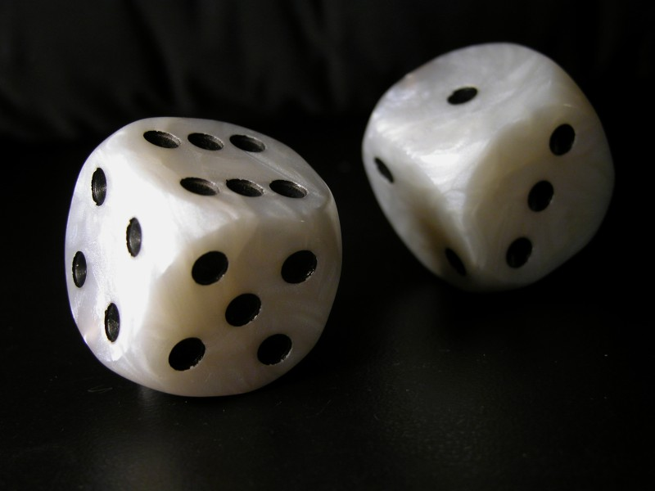
Level 1, play for real!
Reminders and notes
When you hide a column, put existing tickets on top of it and deal with them in the next round
Re-split tickets that were sent back at product-backlog!
If you reach the end of the tracking sheet, start again from the left
If in doubt: check the rules, or ask an animator
From Wikipedia, by Gaz, CC BY-SA 3.0
Let's open sleeve 'Level 1' together
Pick a random 'free' unfair advantage best practice to start with. If they get 'Craftsmanship', no luck, they start with nothing :-(
Pause for a while and read out loud the reference sheet section about this new practice.
Apply the actions of this best practices and resume the game.
As before, the production player should keep track of the delivered features per round
Notes:
10m | 40m -> 50m
----
Now that everyone masters the game, let's play for real!
Let's open the 'Level 1' sleeve together
7 best practice game cards presenting the different practice improvements that are possible in the game.
Column hiders that you will use to 'skip' columns when improvements tell you to do so.
A practice reference sheet, that you'll read aloud when you master a new improvement.
Pick a random 'free' unfair advantage best practice. If they get 'Craftsmanship', no luck, they start with nothing :-(
Pause for a while and read out loud the reference sheet section about this new practice.
Apply the actions of this best practices, and resume the game.
As before, the production player should keep track of the delivered features per round

Slide 11
Level 2
Reminders and notes
Red tickets still need to split
Don't roll the dice for red tickets
Pause and read the reference sheet section aloud
If you reach the end of the tracking sheet, start again from the left
If in doubt: check the rules, or ask an animator
Let's open sleeve 'Level 2' together
Discuss and agree about what skill you want to invest in
When acquire a new skill, pause and read the reference documentation aloud
Notes:
20m | 50m -> 1h10
----
You now have red (improvement) tickets that you can use to master a new skills.
Let's open the 'Level 2' sleeve together
there are red (improvement) tickets that you will use to track your progress about mastering new best practices.
there is the 'How to master new best practices' reference card. It says that you'll need to pass an red ticket from funnel to production to master a new best practice.
Discuss until you come to an agreement about what skill you want to invest in.
When the improvement ticket reaches production, pause and read the best practice reference documentation aloud.
Enforce starting an improvement every 5 minutes

Slide 12

Learning Log
“In what ways does this information change previous perceptions you’ve held about built-in quality?
How do you think you might use this information?
Be ready to share with your table”
Notes:
10m | 1h10 -> 1h20
----

Slide 13

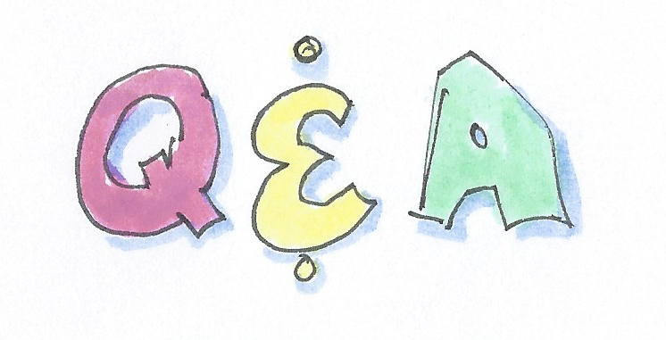

@ ahmadatwi
https://ahmadatwi.me/
@pbourgau
http://philippe.bourgau.net
@work_at_murex
https://www.murex.com
https://philippe.bourgau.net/built-in-quality-game/
@Work_At_Murex

Slide 14
Takeaways
“Quality is free … but only for those who are willing to pay for it!” Tom de Marco
Being busy is a pretty bad measure of productivity
We can workaround rework with slack time !
Streamline the predictable (TDD, BDD, CI, DevOps)
Experiment early against risks (Lean Startup, Walking Skelton)
Notes:
-> 50m

Slide 15
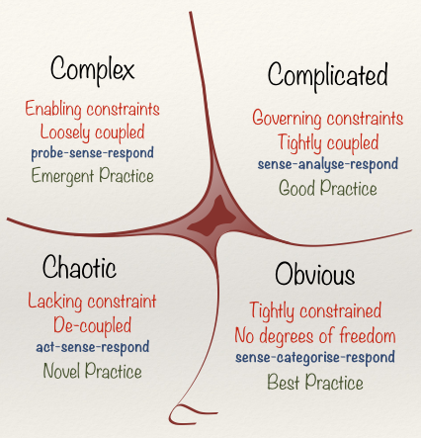
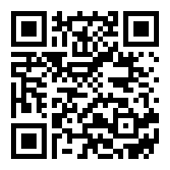
Cynefin framework
Artificial variability
Inherent variability
https://en.wikipedia.org/wiki/Cynefin_framework

Slide 16
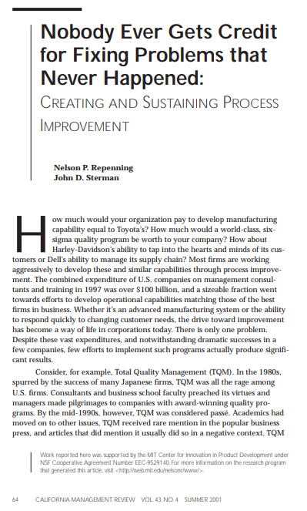
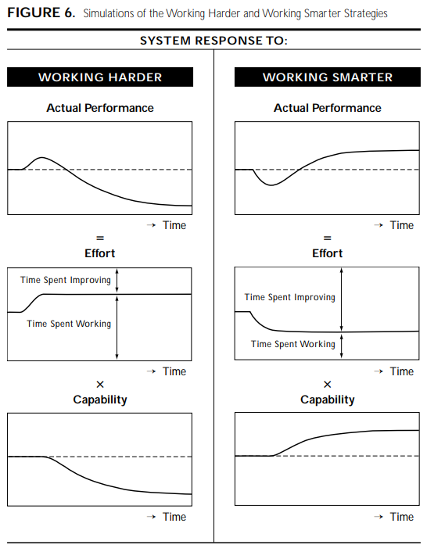
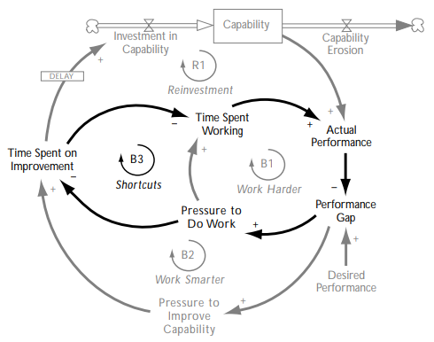
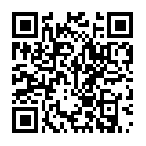
http://web.mit.edu/nelsonr/www/Repenning=Sterman_CMR_su01_.pdf

Slide 17
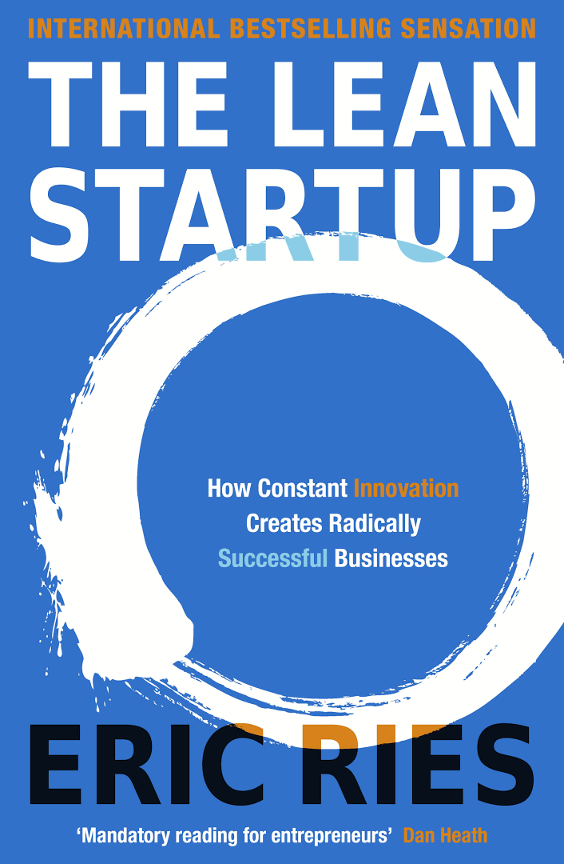
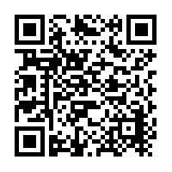
In the book Lean Startup, Eric Ries uses the anecdote of Food on the Table, a grocery shopping service that figures out what you like eating, then compiles the shopping list at specific stores that will save you the most money. Their concierge MVP involved the founder personally scrounging coupons and compiling shopping lists for their early customers.
https://www.goodreads.com/book/show/10127019-the-lean-startup?from_search=true

Slide 18
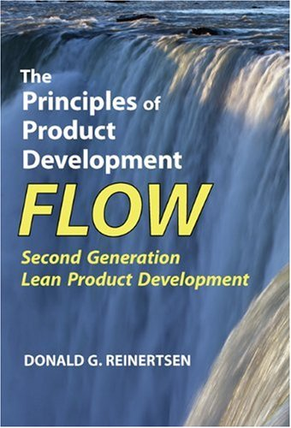
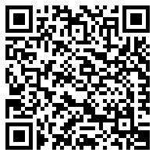
“Variability principle #7, The Principle of Small Experiments:
Many small experiments produce less variation than one big one.”
https://www.goodreads.com/book/show/6278270-the-principles-of-product-development-flow

Slide 19
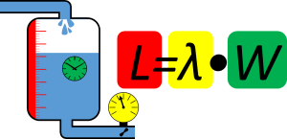

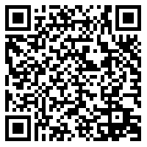
What Does This Mean?
Stay away from 100% utilization…
Try to reduce variation…
If you have high variability, try to use lower utilization…
If you have high utilization, try to reduce variability…
https://www.allaboutlean.com/kingman-formula/
“High utilization plus variability equals long processing times
…
Variability in a manufacturing environment arises from unreliable equipment, unpredictable yields, glitches in human performance, fluctuations in order rates and sizes, and numerous other sources. When a production system whose components are working at close to full capacity is subjected to the stress of such variability, resulting waiting times can become very long compared with actual processing times. "This is a scientific principle," Harrison noted, predicted by a rigorous mathematical treatment known as queuing theory.”
https://web.stanford.edu/group/AIM/AIMPrograms/EventsArchives/wkshparchives/Variability.html

Slide 20
Idea | Feature | Backlog | Build | Test | Pre-prod | Prod
BUG
BUG
Perturbation
Multitasking
Stress
Firefighting
Quick fixes
Delays
…
Perturbation
Multitasking
Stress
Firefighting
Quick fixes
…

Slide 21
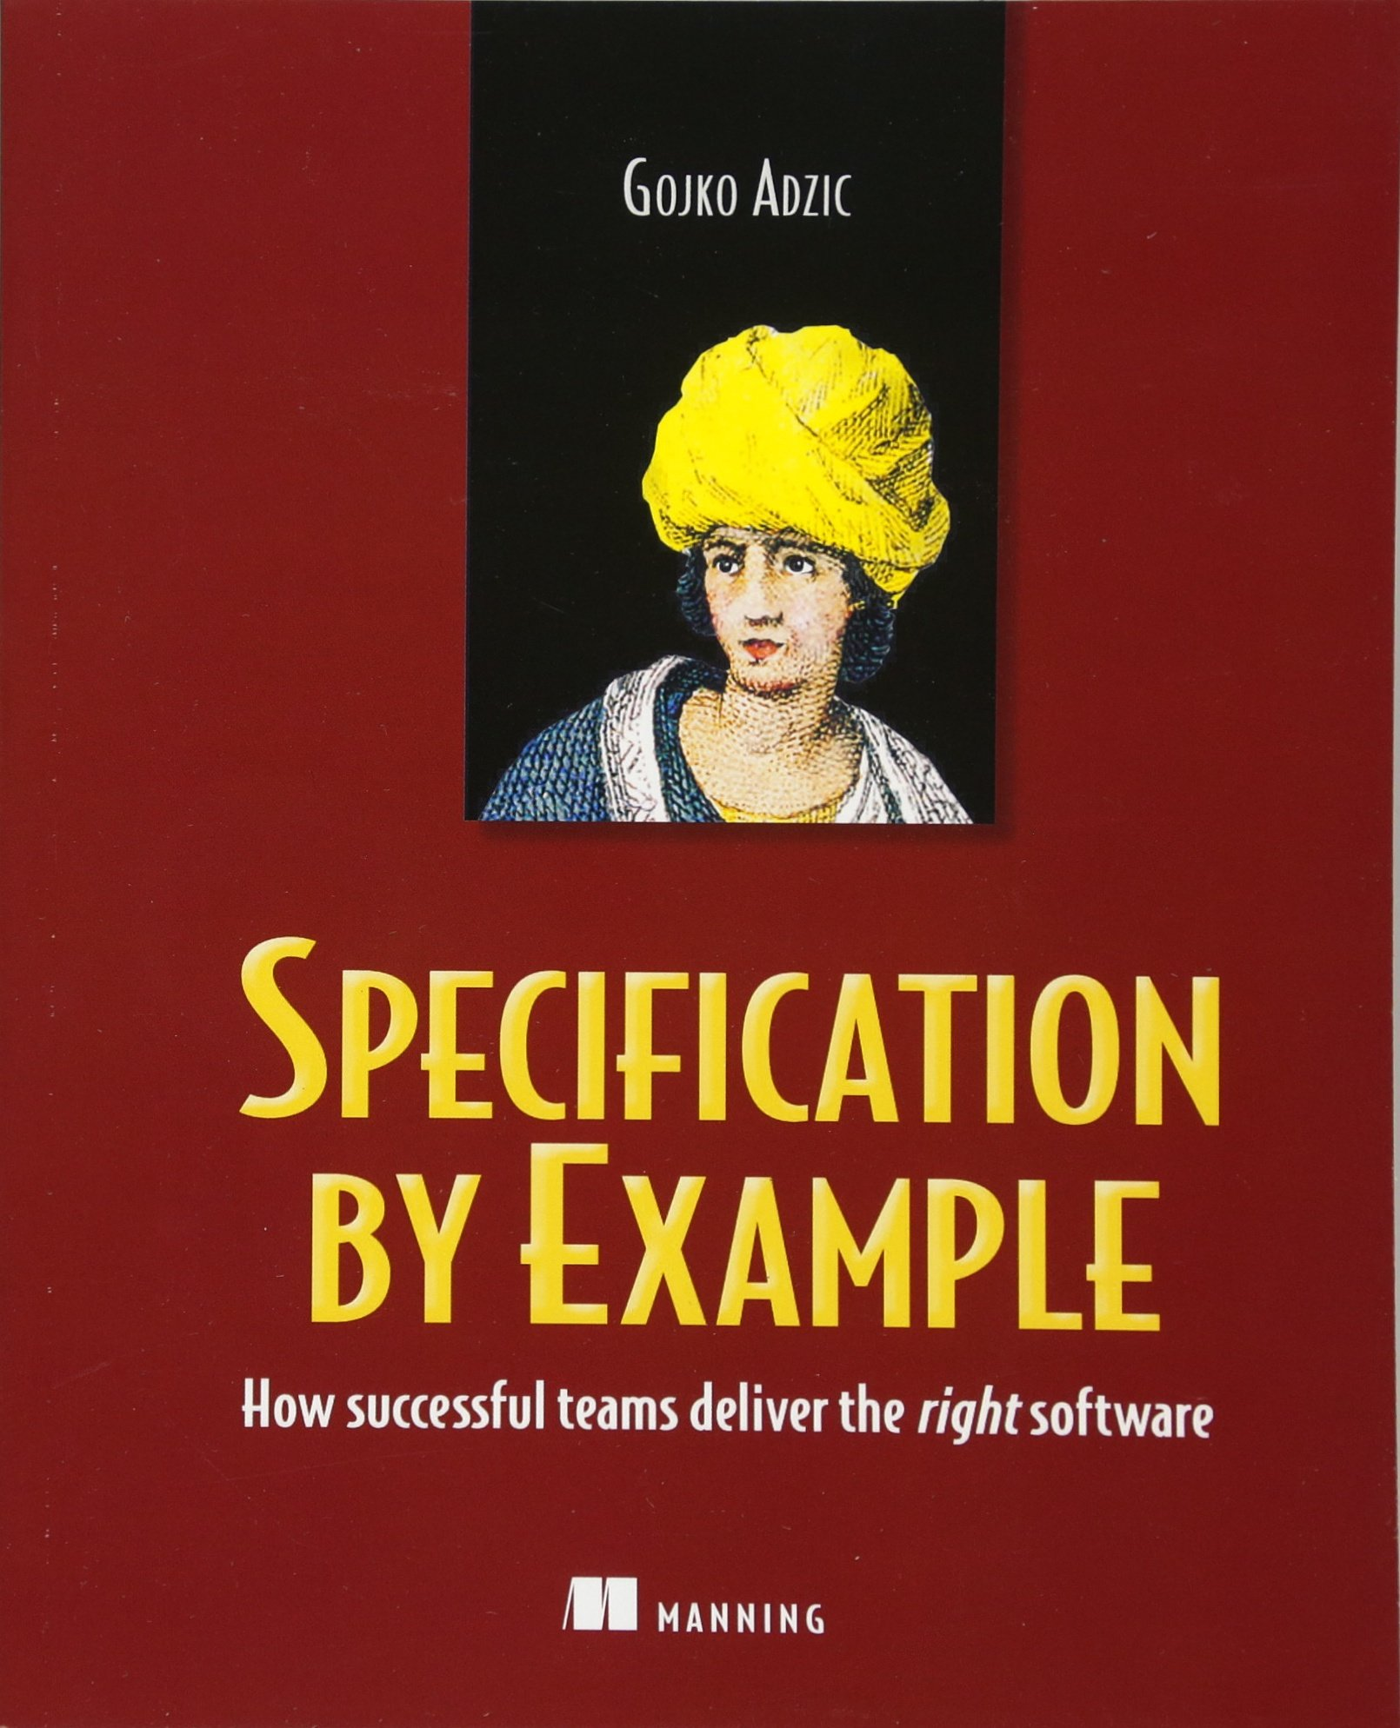
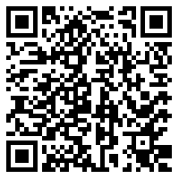
“We went live with a large customer [a big airline] with very few issues and had only one severity 1 issue during [business acceptance] testing, related to fail-over”
At BNP Paribas, the Sierra project is another great example of how Specification by Example leads to high-quality products. […] The project has been live since 2005 “with no major incidents in production,” according to Andrew Jackman, a consultant developer on the Sierra project.
Similar results were obtained by Bekk Consulting for a branch of a major French bank with a car-leasing system. […] they had only five bugs reported in the two years since the system went live, even though the software is now maintained by a completely new team.
In 2004, the Iowa Student Loan development team implemented Extreme Programming by the book to improve the quality of their software. When their next project went to production, they prepared to handle bugs similarly to the way they did things in the past. Over the next 12 months, the new system only had half a dozen bugs. This proved to the management that agile development, especially writing tests first, was a good idea and that it significantly improves quality.
https://www.goodreads.com/book/show/10288718-specification-by-example?from_search=true

Slide 22

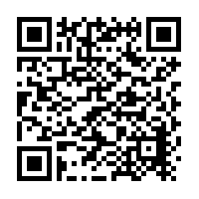
4 metrics
Lead Time
Frequency of release
Time to restore
Frequency of failure
Predict IT performance
But also predict company performance!
https://www.goodreads.com/book/show/35747076-accelerate?from_search=true

